Slide 1

Air Quality Analysis
Haocheng Zhu
Isabel Souza Shiratsubaki
Anh Hoang
Group 20

Slide 2
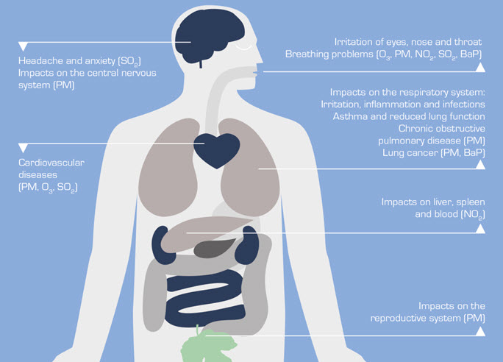
Overview
Air quality is fundamental to our well-being
On average, a person inhales about 14,000 litres of air every day, and the presence of contaminants in this air can adversely affect people’s health
Global warming is serious concern
Notes:
Sources:http://www.mfe.govt.nz/more/environmental-reporting/air/air-domain-report-2014/why-good-air-quality-important

Slide 3
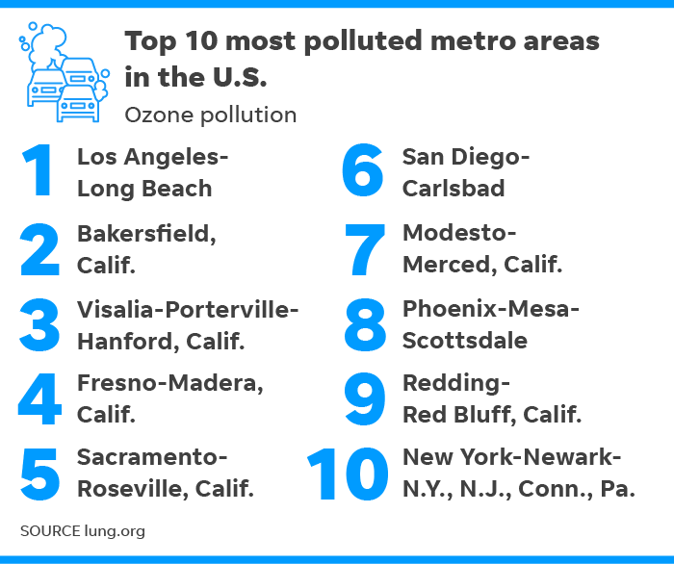
Motivation
California has eight out of ten most polluted cities in the nation
The Los Angeles/Long Beach and San Diego area took the dubious distinction of being the nation's most ozone-polluted city as it has for nearly the entire 19-year history of the report.
Outdoor air pollution continues to threaten the lives and health of millions of people in the U.S.
Notes:
https://www.usatoday.com/story/news/nation/2018/04/18/california-has-eight-10-most-polluted-u-s-cities/524815002/

Slide 4
Objective
Creating a system to analyze the air quality
based on locations, its content and time

Slide 5
Datasets
Pollution in US open dataset: https://www.kaggle.com/sogun3/uspollution
The dataset presents information about the state, the county, the city, the date of the measurements (from 2000 to 2016), and measurements of the pollutants level in the air
The dataset format is csv (size: 382 MB)

Slide 6
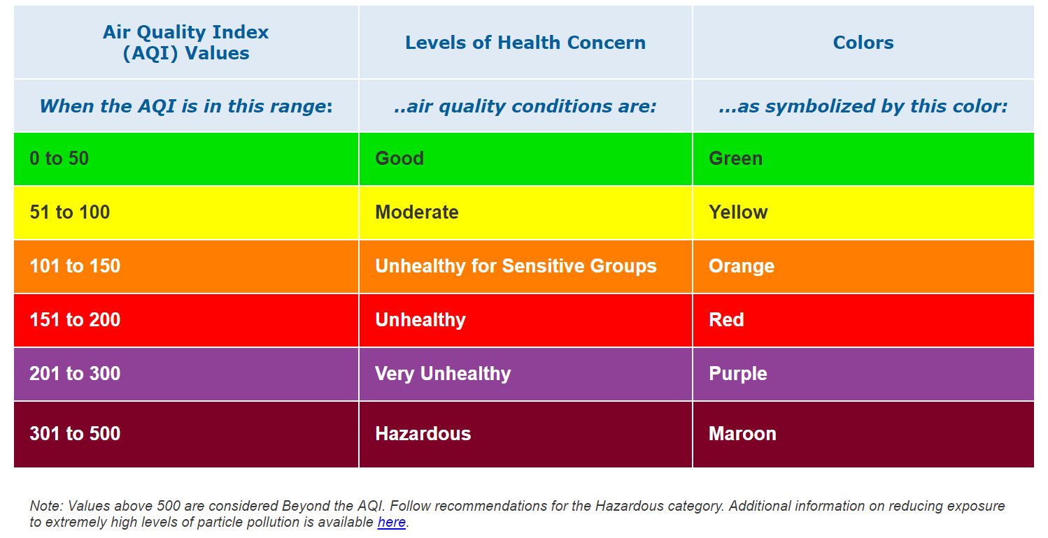
Methodology: EPA Category
Using the data from Air Quality Index (AQI) Basics to rate the air quality of each state and difference time of the year

Slide 7
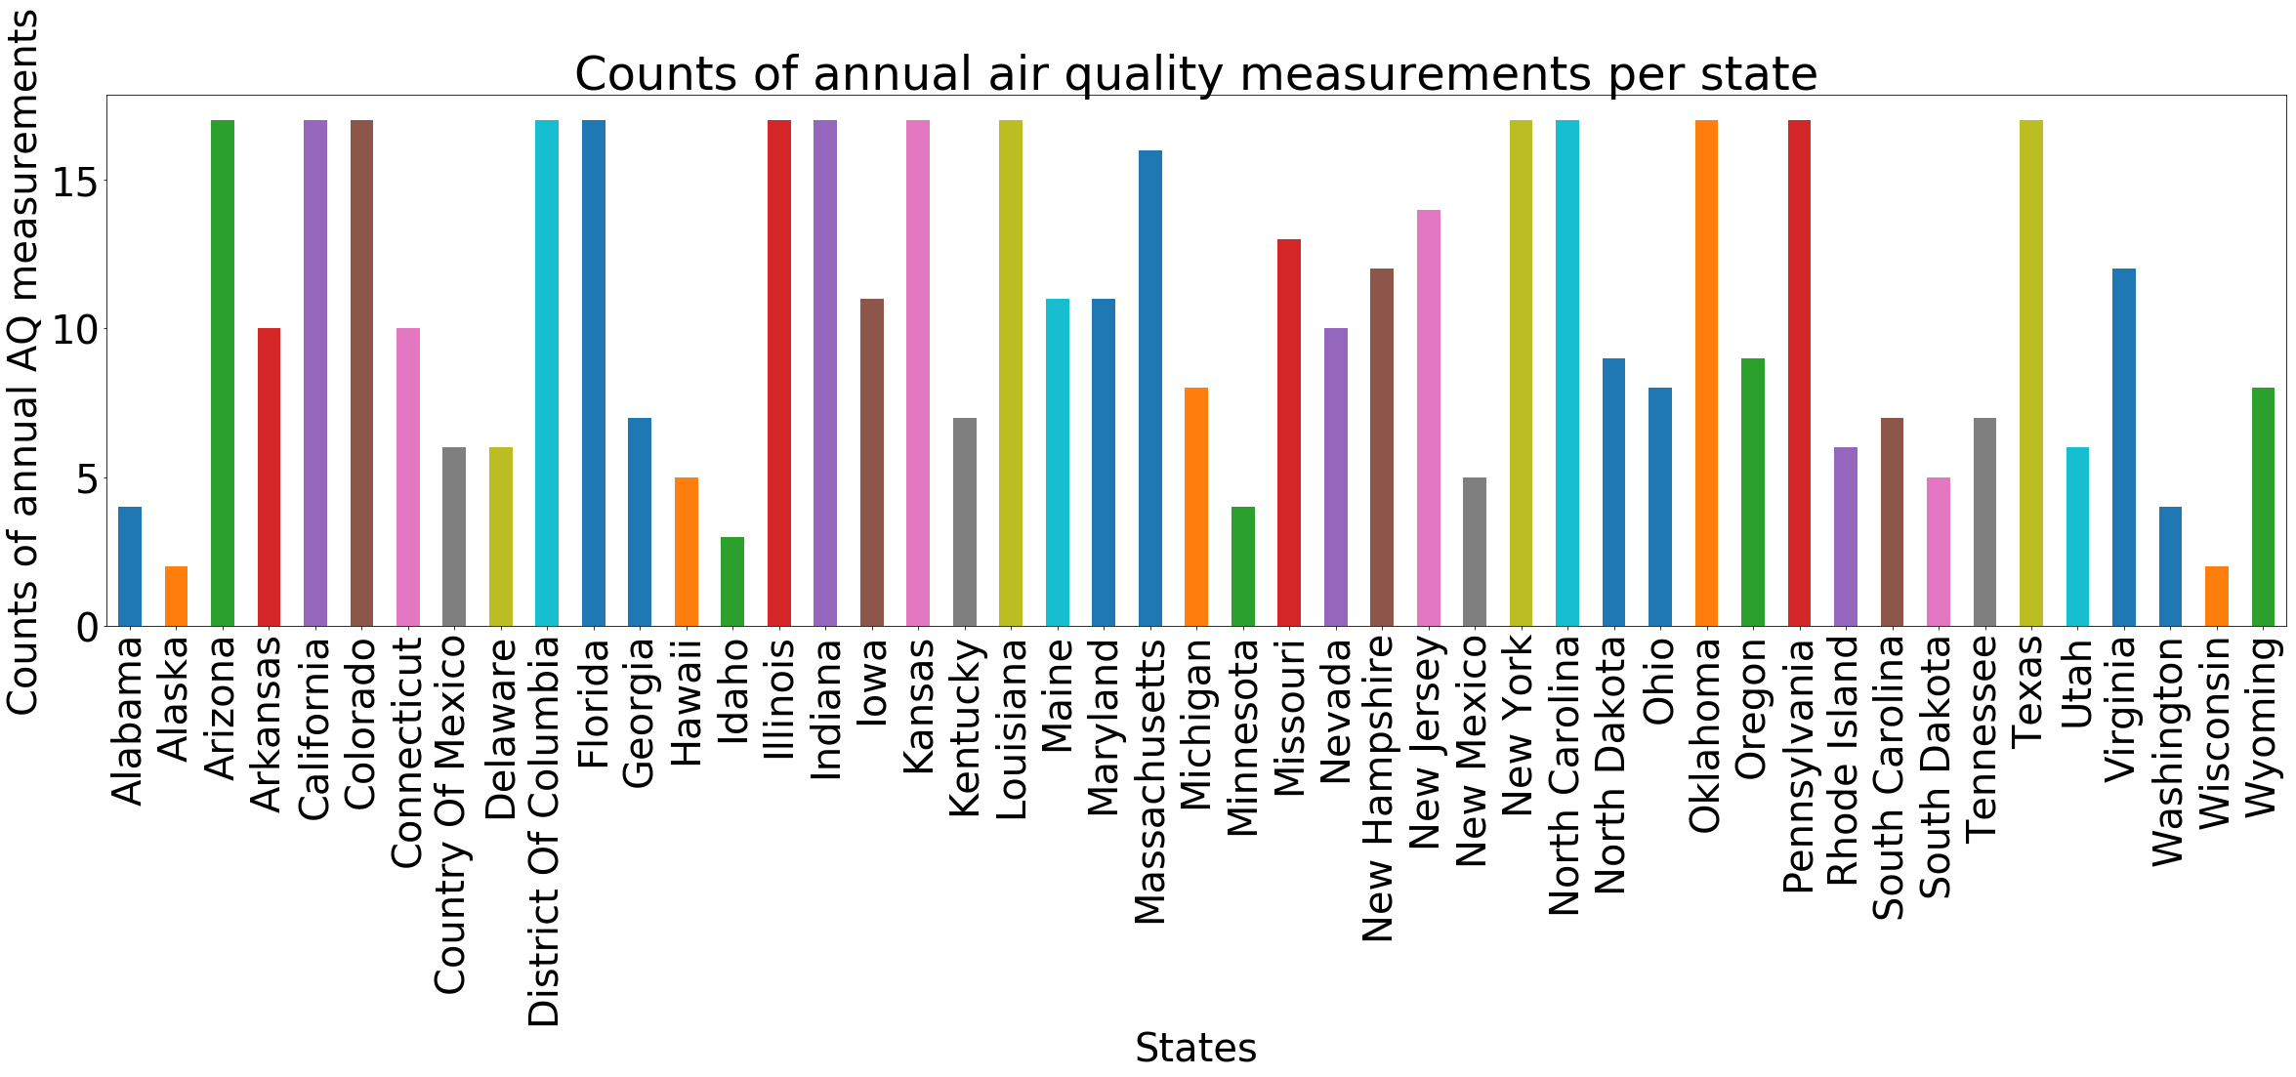
Air quality was measured across 50 states. However, the number of data values were vary from state to state.

Slide 8
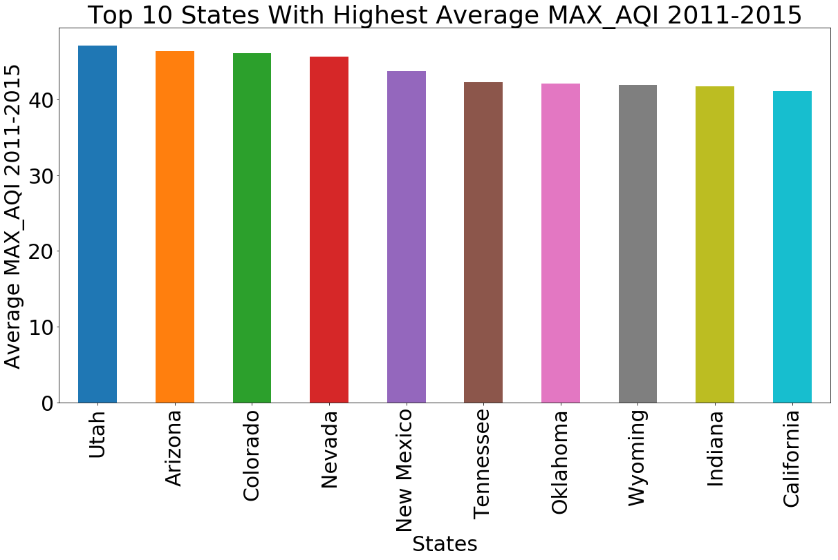
Top 10 States with Highest Average of AQI Max from 2011-2015
CA

Slide 9
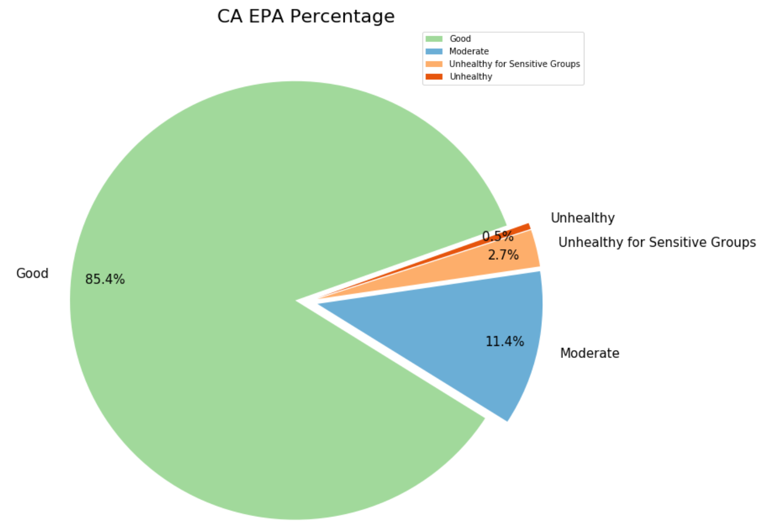
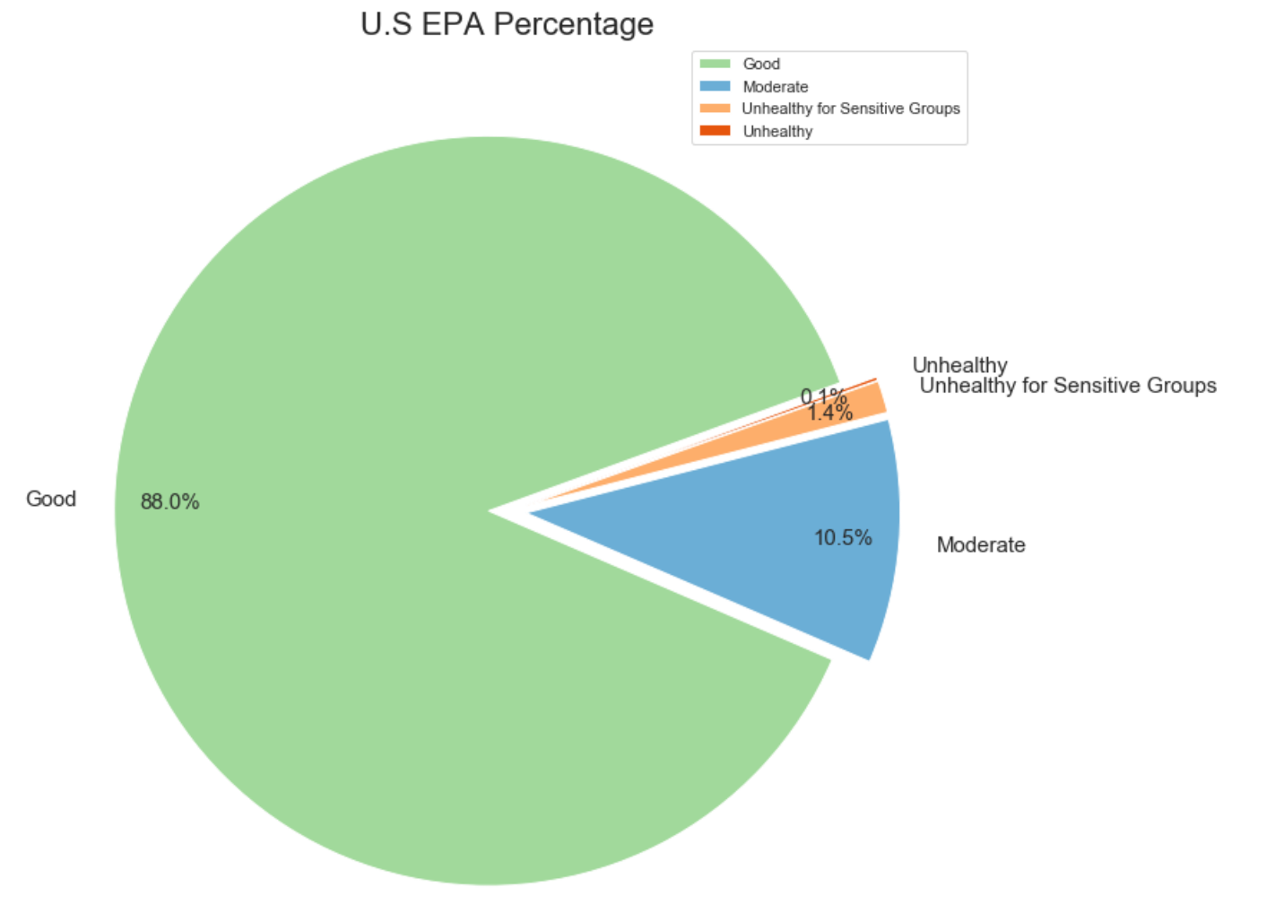
EPA Classification CA vs U.S.A Average
California has much more percentage of unhealthy days than U.S average

Slide 10
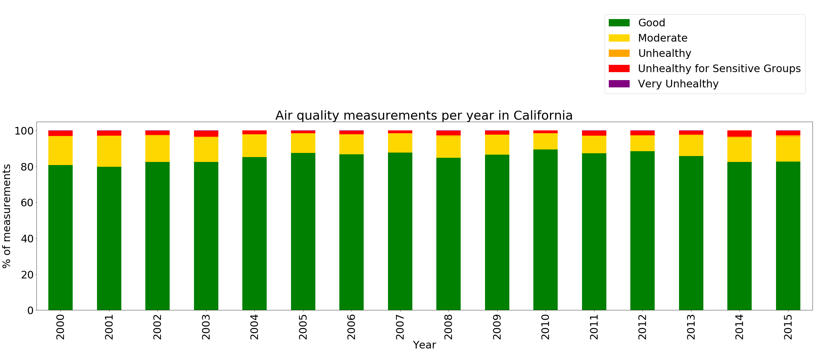
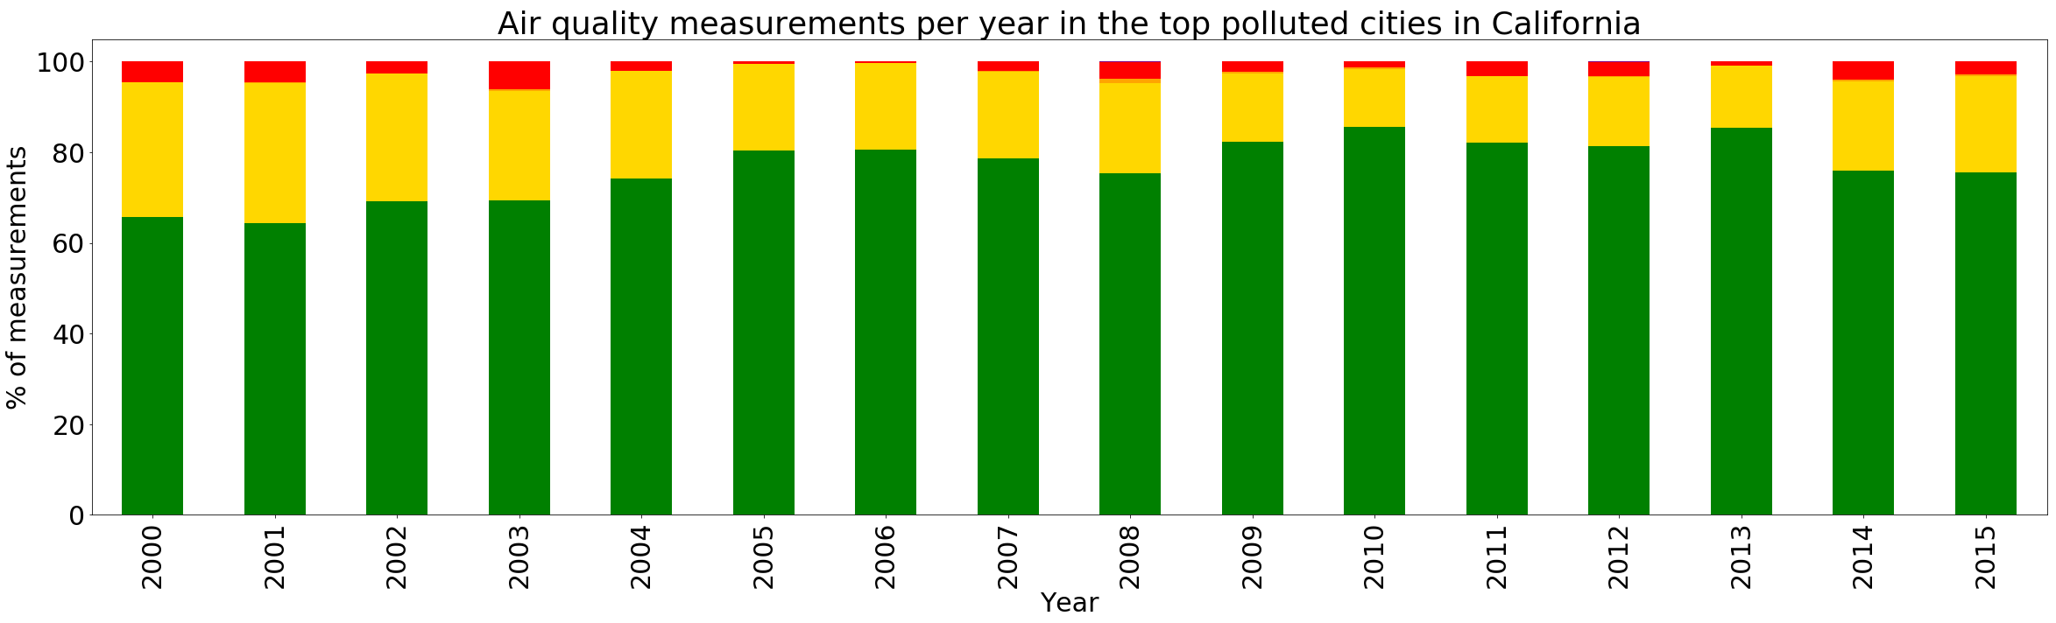
Air Quality CA versus Top Polluted Cities in CA
The number of Moderate air quality measurements increase when we filtered only top polluted cities in CA
More unhealthy air quality measurements were verified between 2000 and 2004

Slide 11
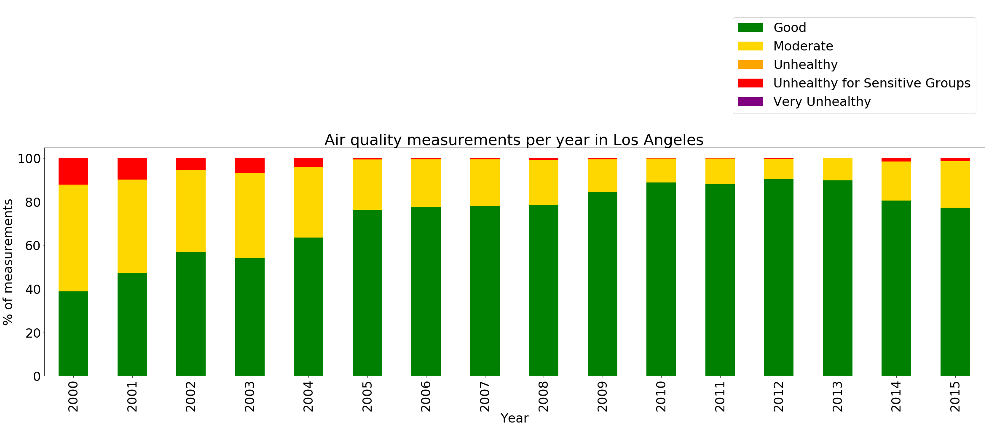
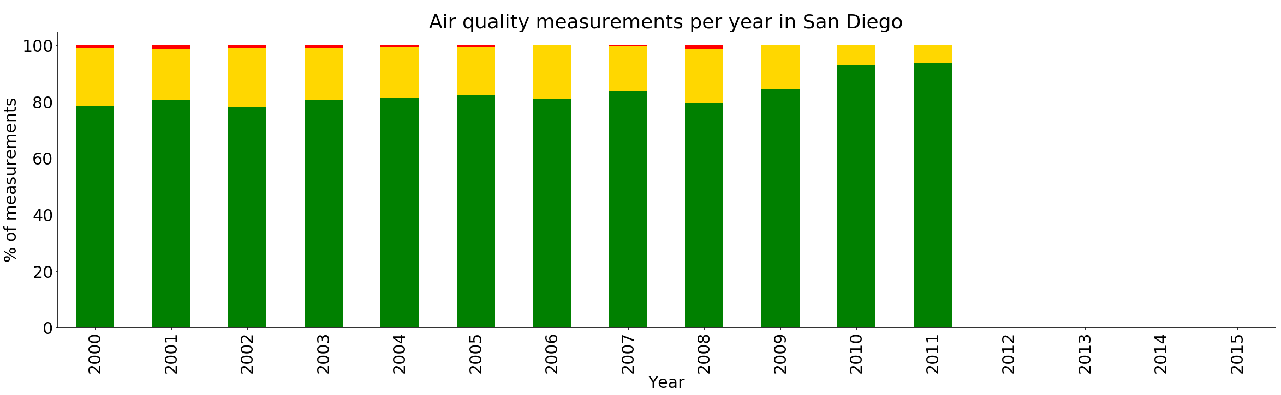
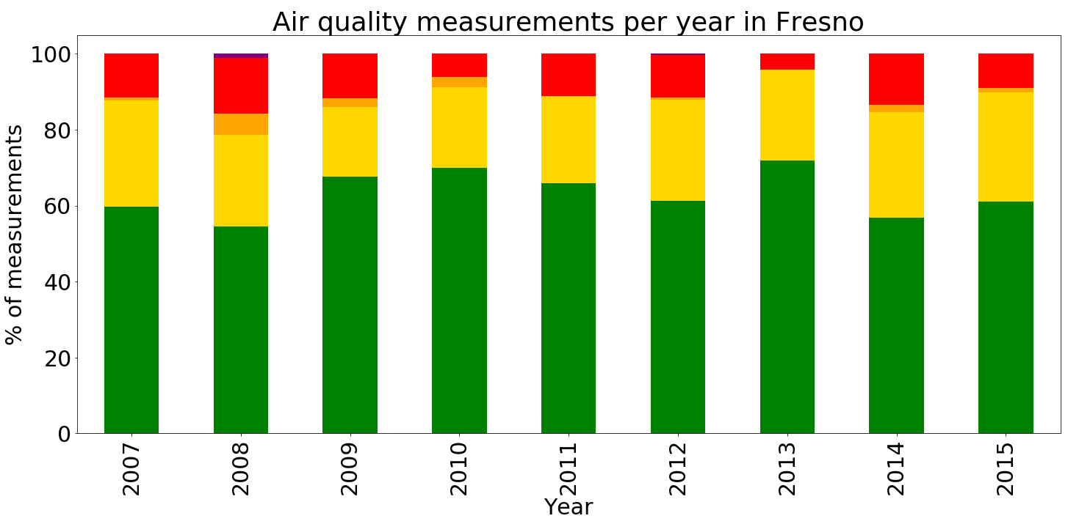
Fresno was the city that presented the worst air quality among other polluted cities, especially in 2008
Overall, LA presents worse air quality than SD over time
LA
SD
Fresno
Notes:
2008 fire in Fresno May 20, 2008

Slide 12
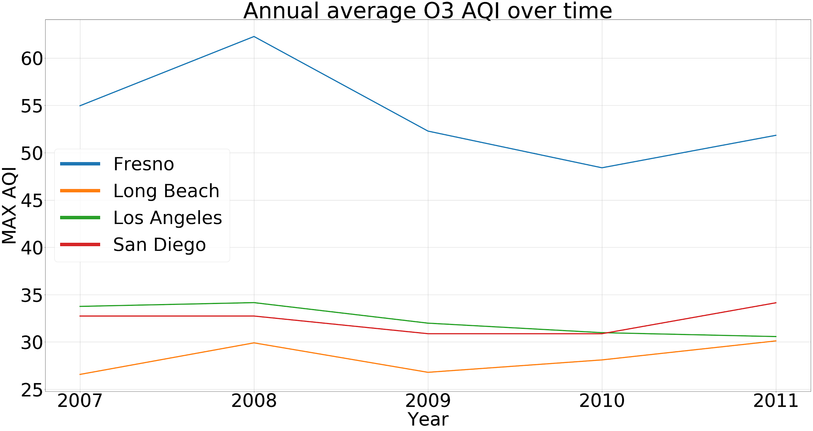
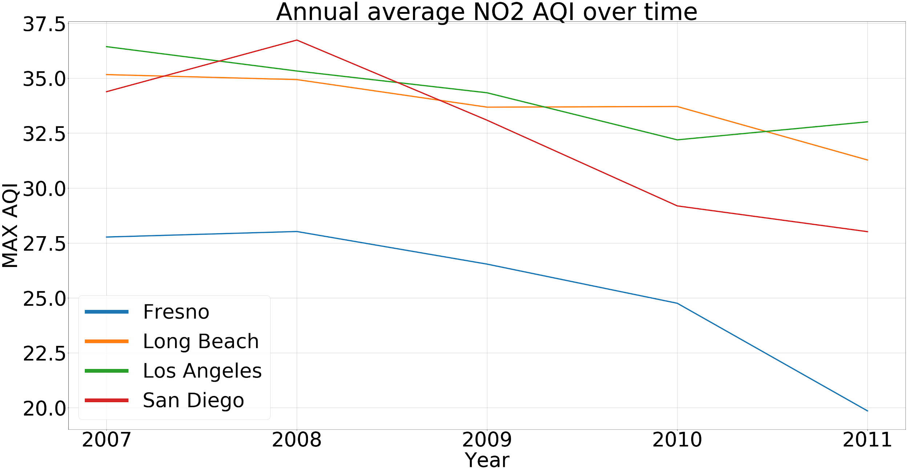
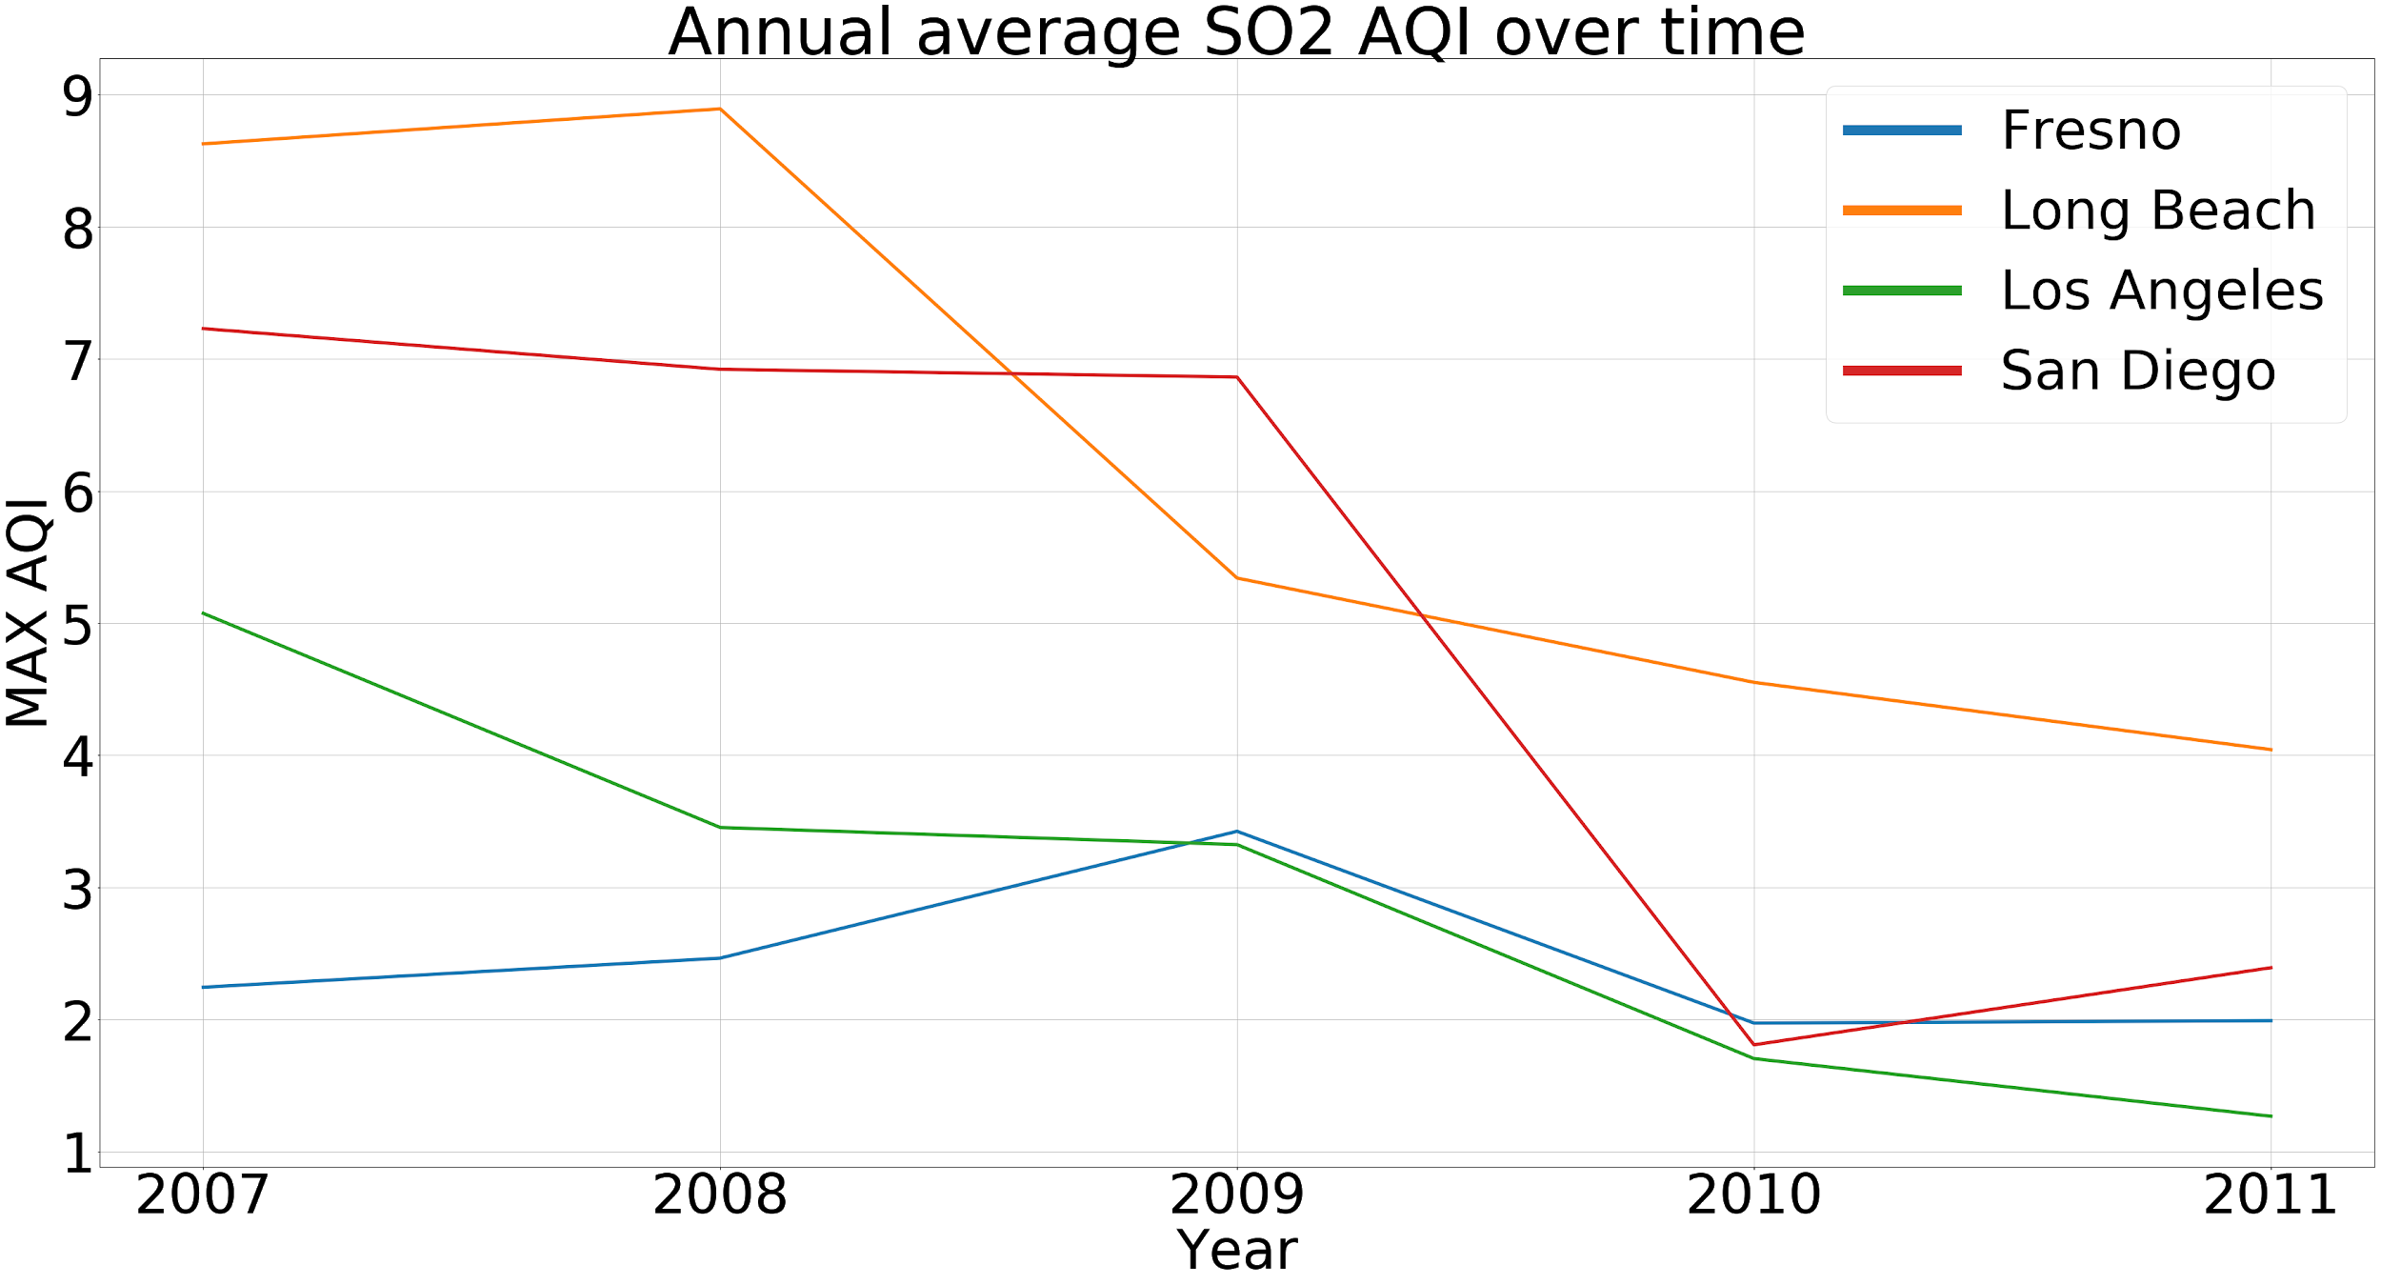
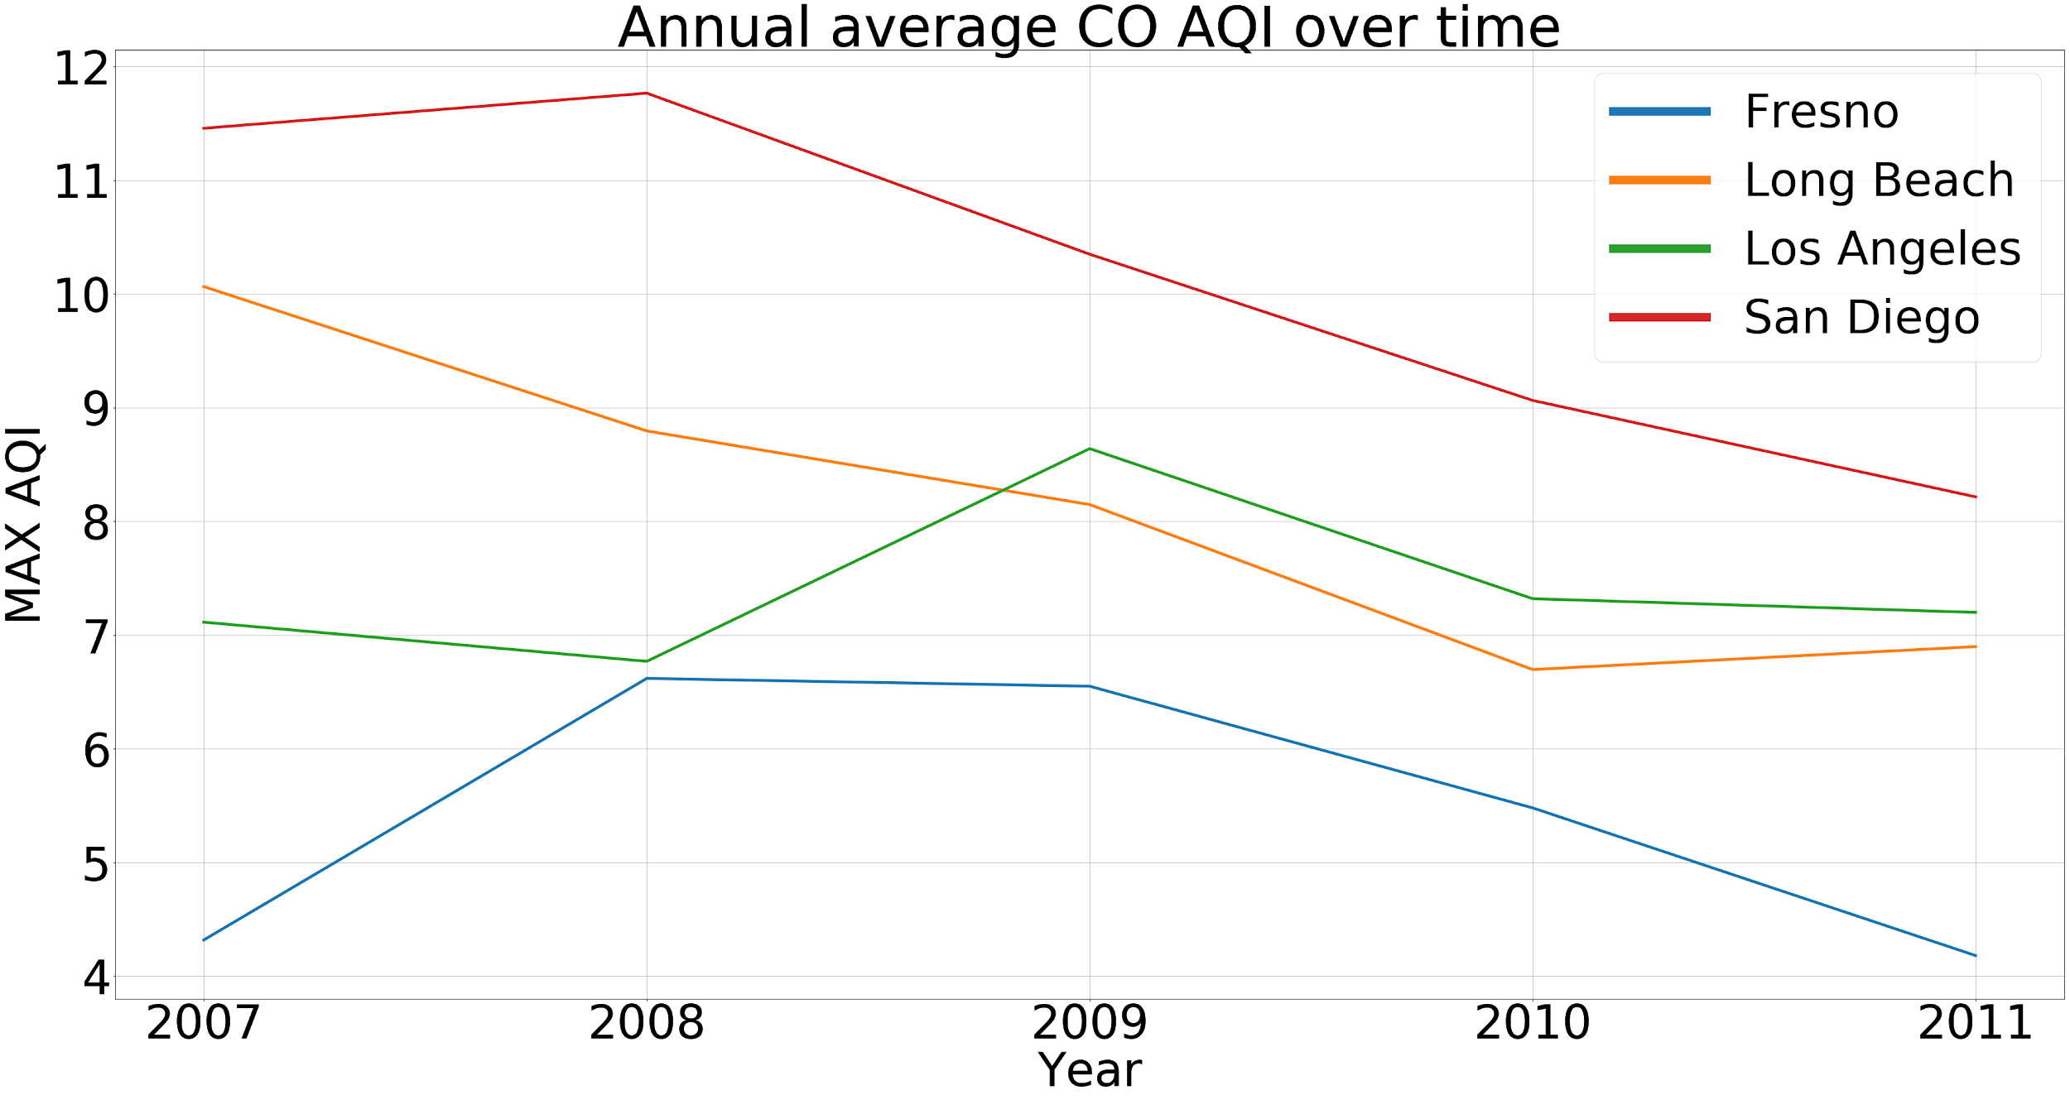
Notes:
San Diego presented the highest CO AQI over time
Long Beach, LA and SD had similar NO2 AQI behavior over time
Fresno was by far the city that presented the highest O3 AQI over time
Long Beach and San Diego presented the highest values for SO2 AQI over time

Slide 13
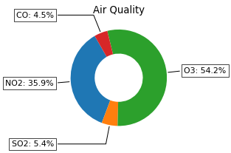
O3 was the most prevalent pollutant gas followed by NO2, SO2 and CO over the period of 2000 to 2016

Slide 14
Conclusion
California air quality is one of the worst in US and it presents bad performance compared to the average of US
Top most polluted cities in CA presented higher AQI than the average in CA
Our results confirm that California is a leader in air pollution among other states, with the highest recorded levels of Ozone (Fresno)
Fresno was the top polluted city in CA that presented the worst performance regarding O3 AQI
O3 is the most prevalent pollutant gas in US air.

Slide 15
THANK YOU

Slide 16
Appendix

Slide 17
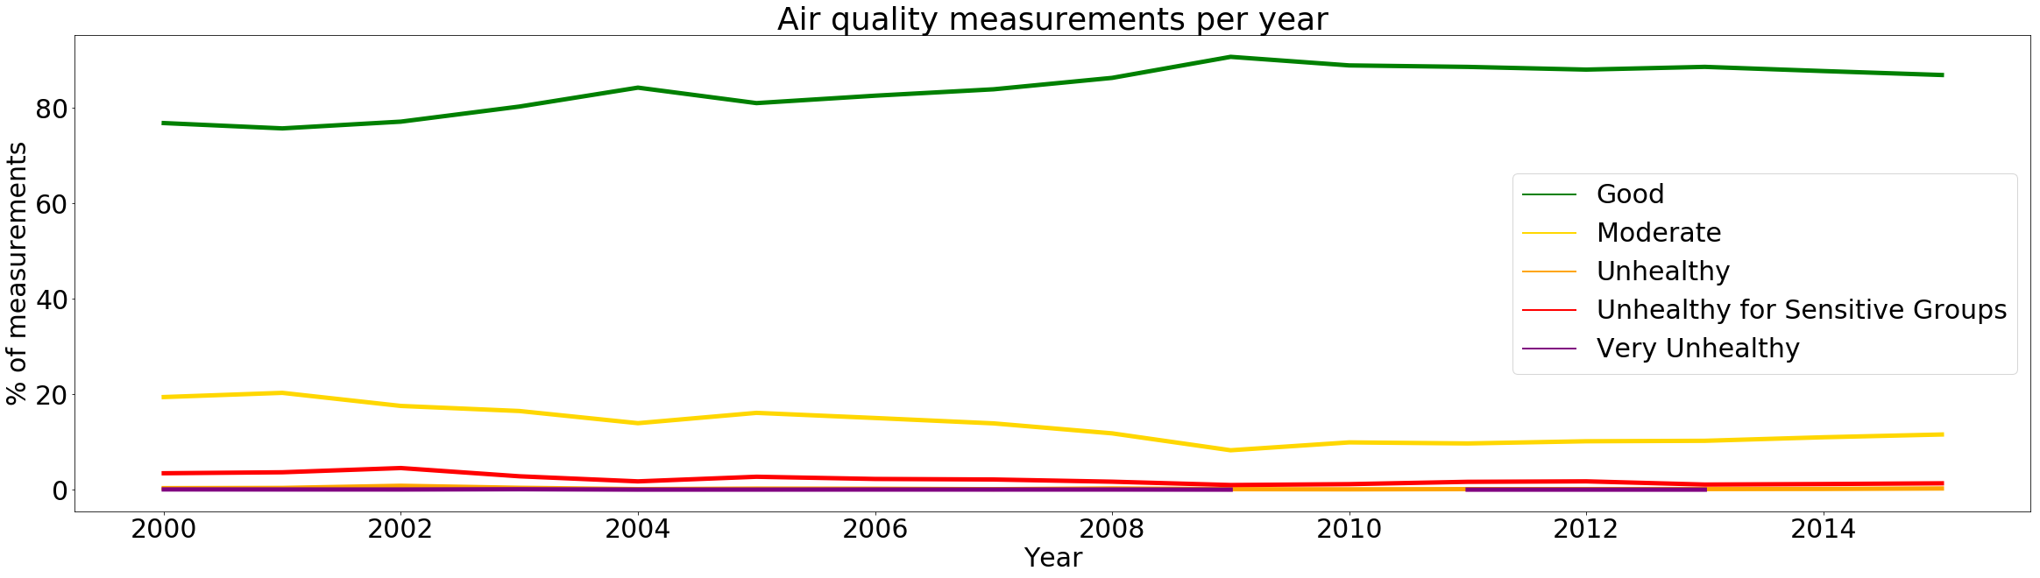
Air quality measurements over time per category

Slide 18
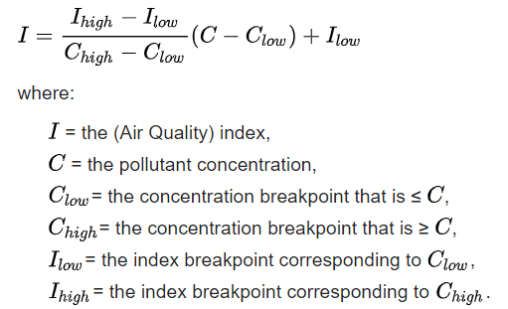
Air Quality Index (AQI) - EPA

